Slide 1
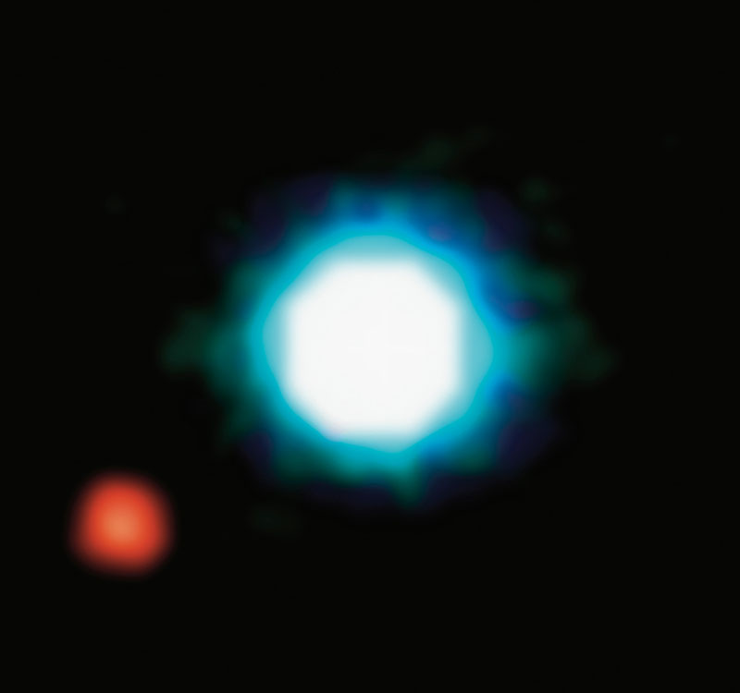
EXOPLANETS
Shall we start packing?
© NASA

Slide 2
EXOPLANETS
– Any planet beyond our solar system
2M1207
Brown dwarf
230 light-years from Earth
2M1207b
Jupiter-like planet
5x Jupiter’s size
Orbits at a distance 55x larger than the Earth to the Sun
© NASA
Notes:
An exoplanet is a planet beyond out solar system which is orbiting a star. They were first discovered in 1988, and ever since the number of new planets has increased steadily.
This is the first image captured from an exoplanet in 2007. This planet is 5 times bigger than Jupiter, and orbits at a distance 55 times larger than the distance from the earth to the sun.
It’s great to find more planets outside of our solar system, but…

Slide 3
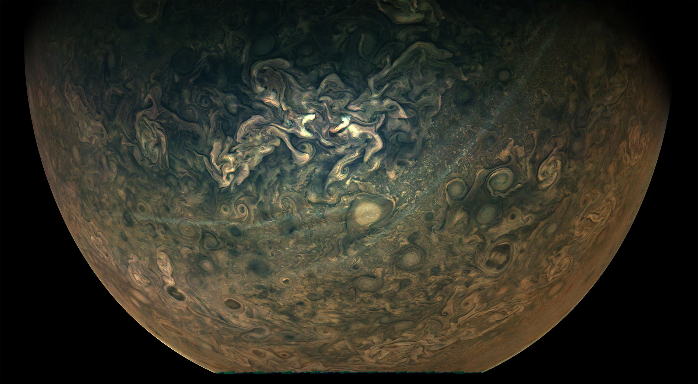
Is there any planet habitable?
Notes:
The question is:
IS THERE ANY PLANET HABITABLE?

Slide 4
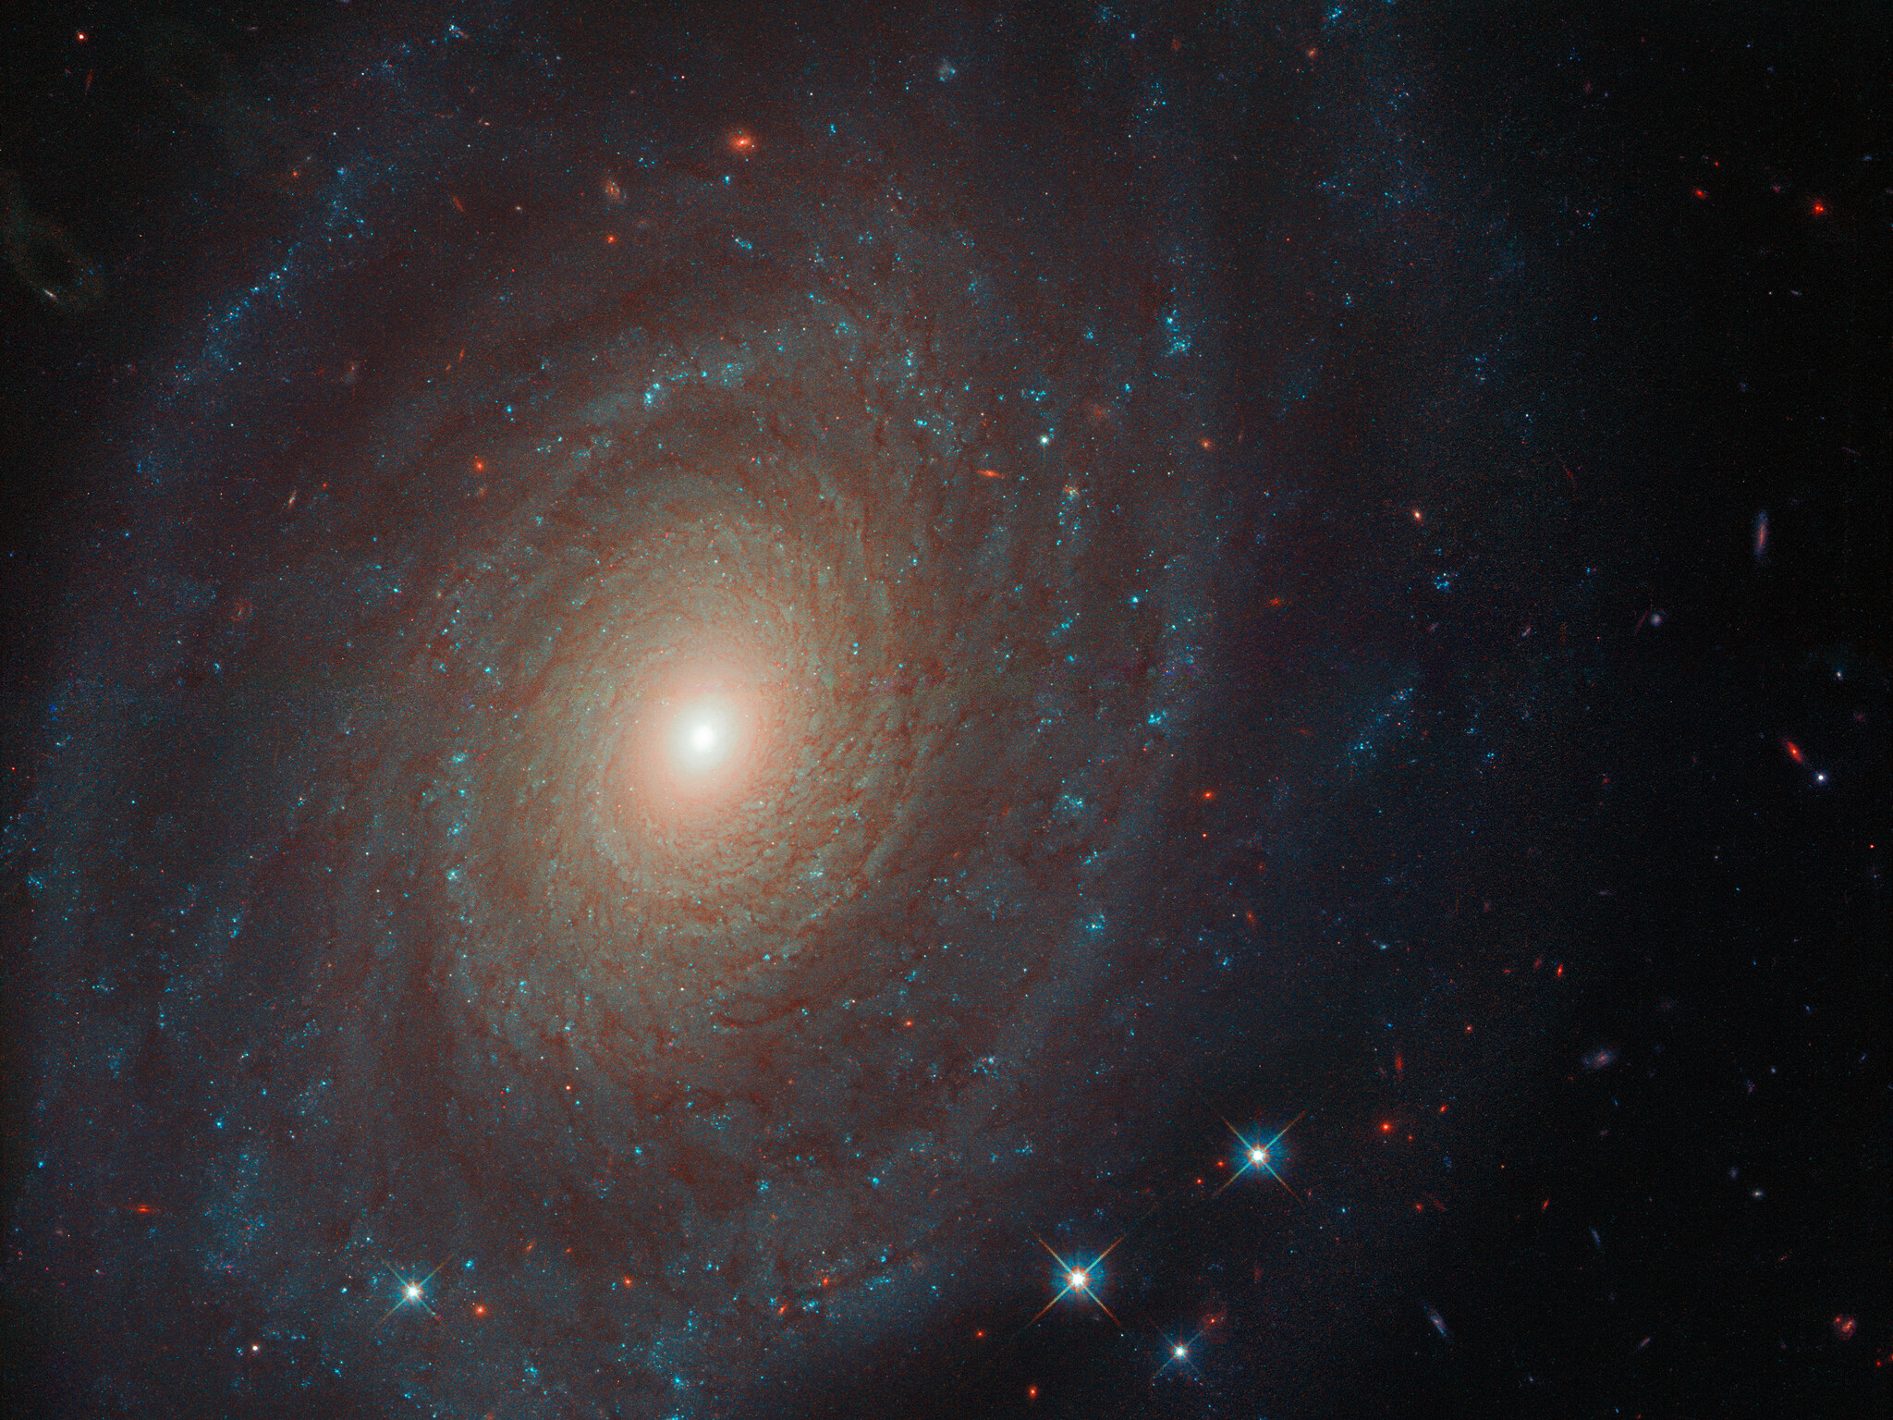
Before booking, you better check the offer…
Similar conditions to Earth:
Planet orbit
Mass of the star
Distance star-planet
Temperature
Atmosphere
Distance Earth-to-planet
Notes:
So what are the conditions that would make life possible in an exoplanet?
We have to look for similar conditions to Earth, and that means:
- The planet orbit around its star
- The mass of the star
- The distance from the star to the planet, which will determine the temperature of the planet
The presence of an atmosphere and its composition
We can approach this by looking at the data that has been collected so far

Slide 5
Before booking, you better check the offer…
Data acquisition:
NASA – Exoplanets API
The Extrasolar Planets Encyclopaedia (EU)
Web scraping for explanation of NASA information
Notes:
The total amount of discovered exoplanets is 4144, as reported by NASA. However, the EU portal for exoplanets reports 4247 planets.
We realized that there are names mismatches and *more planets* registered in EU. For example, GJ 273 e, which was discovered in 2019, is not reported by NASA. The difference might be related to the confirmation methods that vary between the agencies.
Here we present the data from NASA, which is generally considered the most reliable source of information from the space.
By removing the outliers, we observe that most of the planets orbit their host stars in less than 1000 days, but there are also planets that have an orbit period of 7000 days, which is equal to 19 years! Here we can see the earth for comparison.

Slide 6
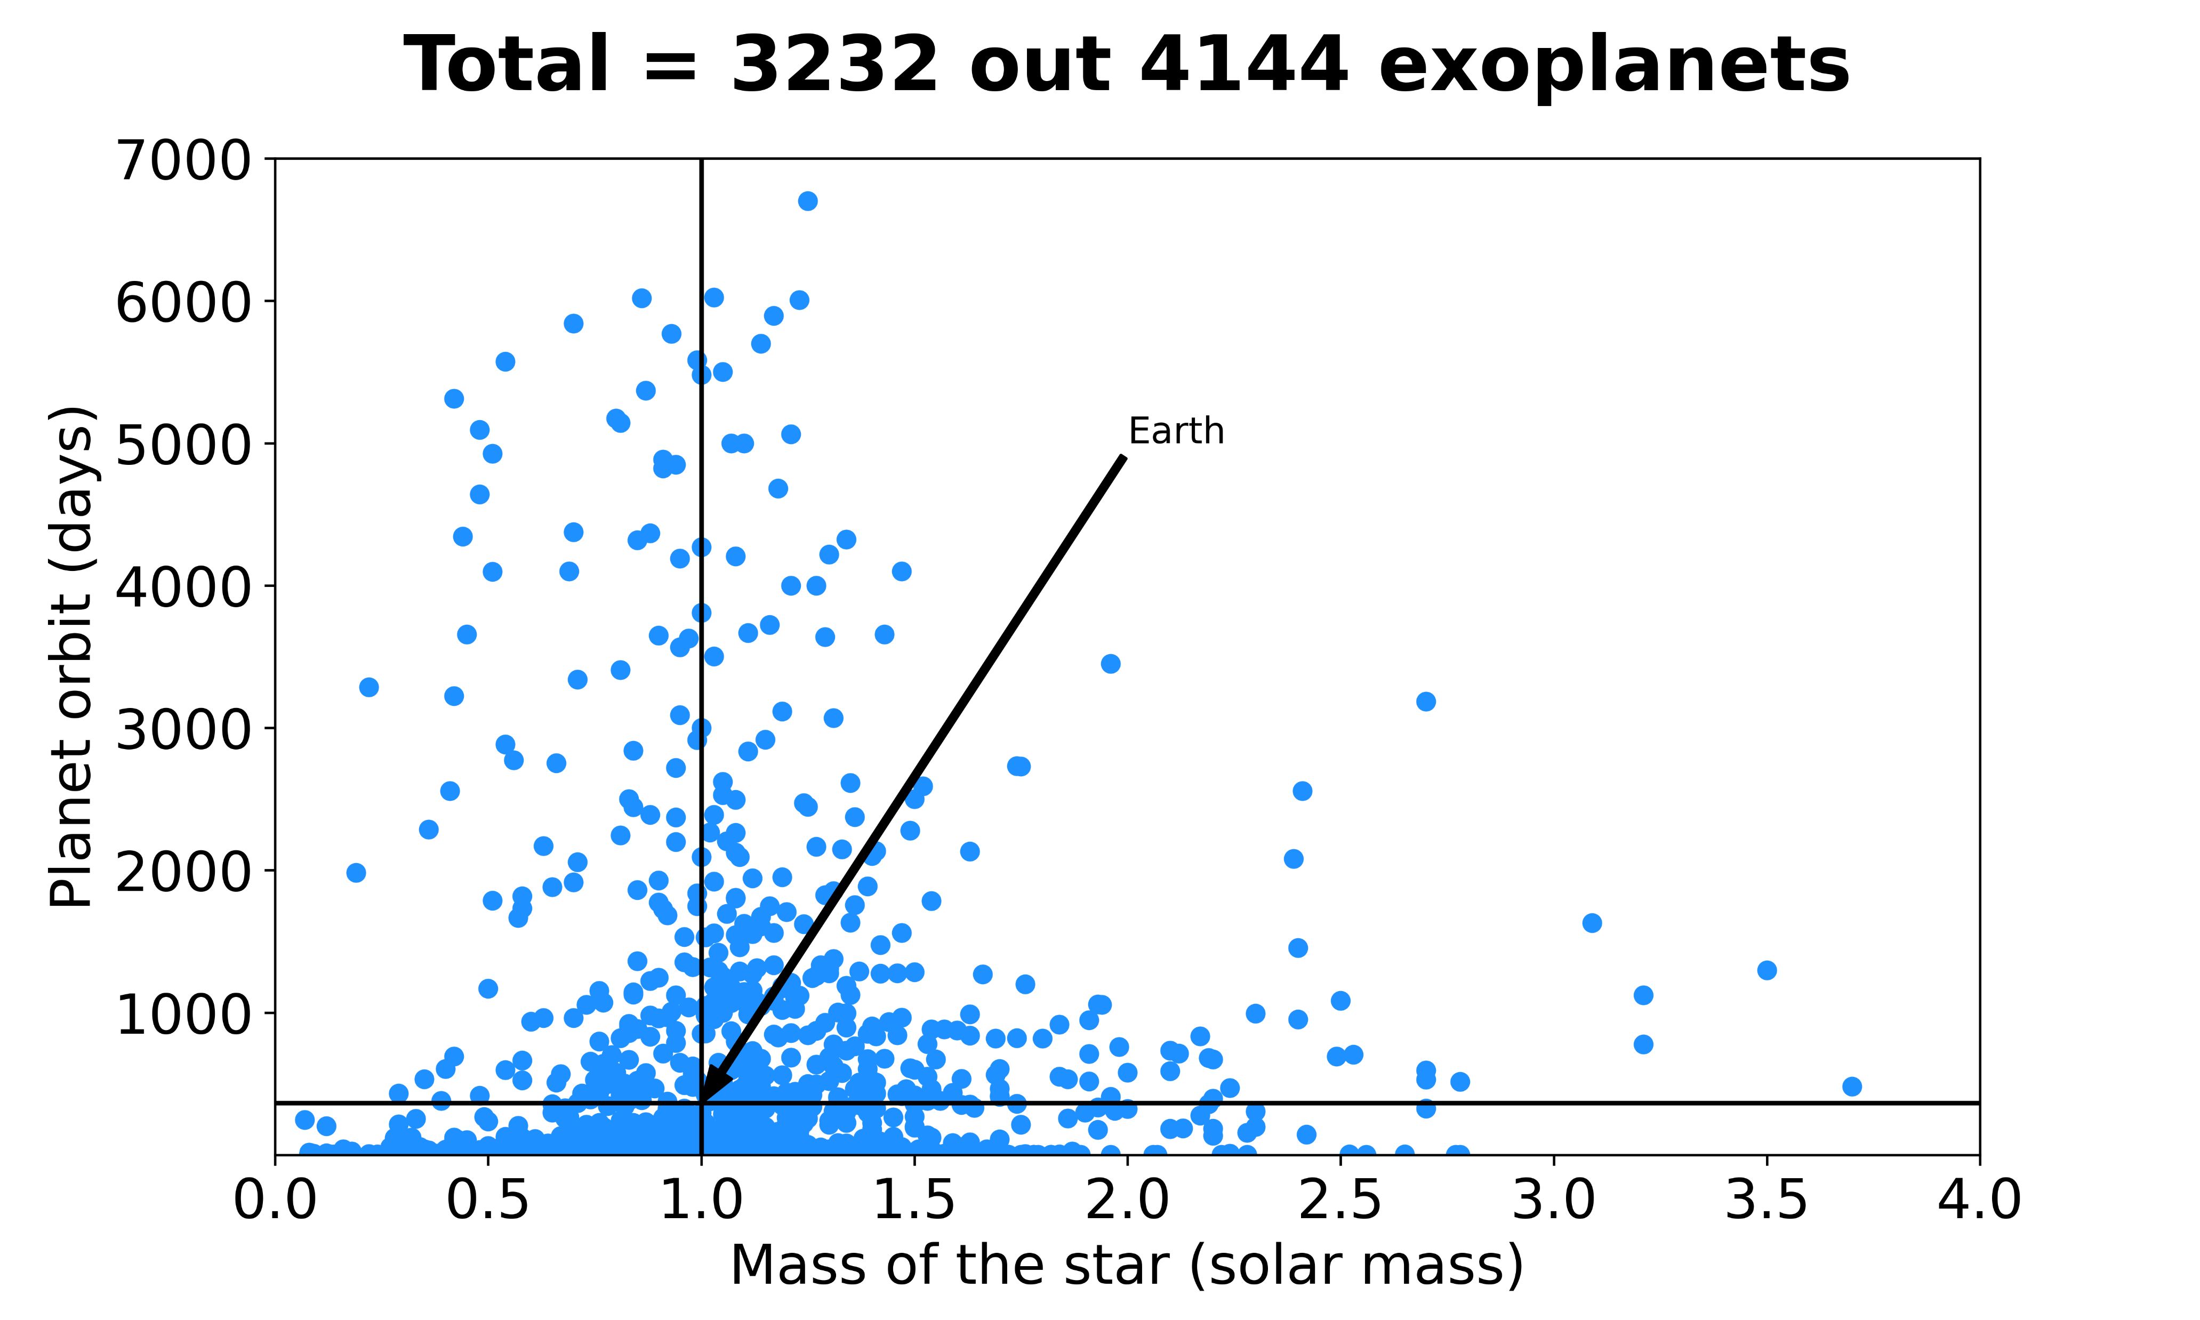
Before booking, you better check the offer…
Two approaches:
Solar mass/planet orbit
Temperature/distance
Notes:
The total amount of discovered exoplanets is 4144, as reported by NASA. However, the EU portal for exoplanets reports 4247 planets.
We realized that there are names mismatches and *more planets* registered in EU. For example, GJ 273 e, which was discovered in 2019, is not reported by NASA. The difference might be related to the confirmation methods that vary between the agencies.
Here we present the data from NASA, which is generally considered the most reliable source of information from the space.
By removing the outliers, we observe that most of the planets orbit their host stars in less than 1000 days, but there are also planets that have an orbit period of 7000 days, which is equal to 19 years! Here we can see the earth for comparison.

Slide 7
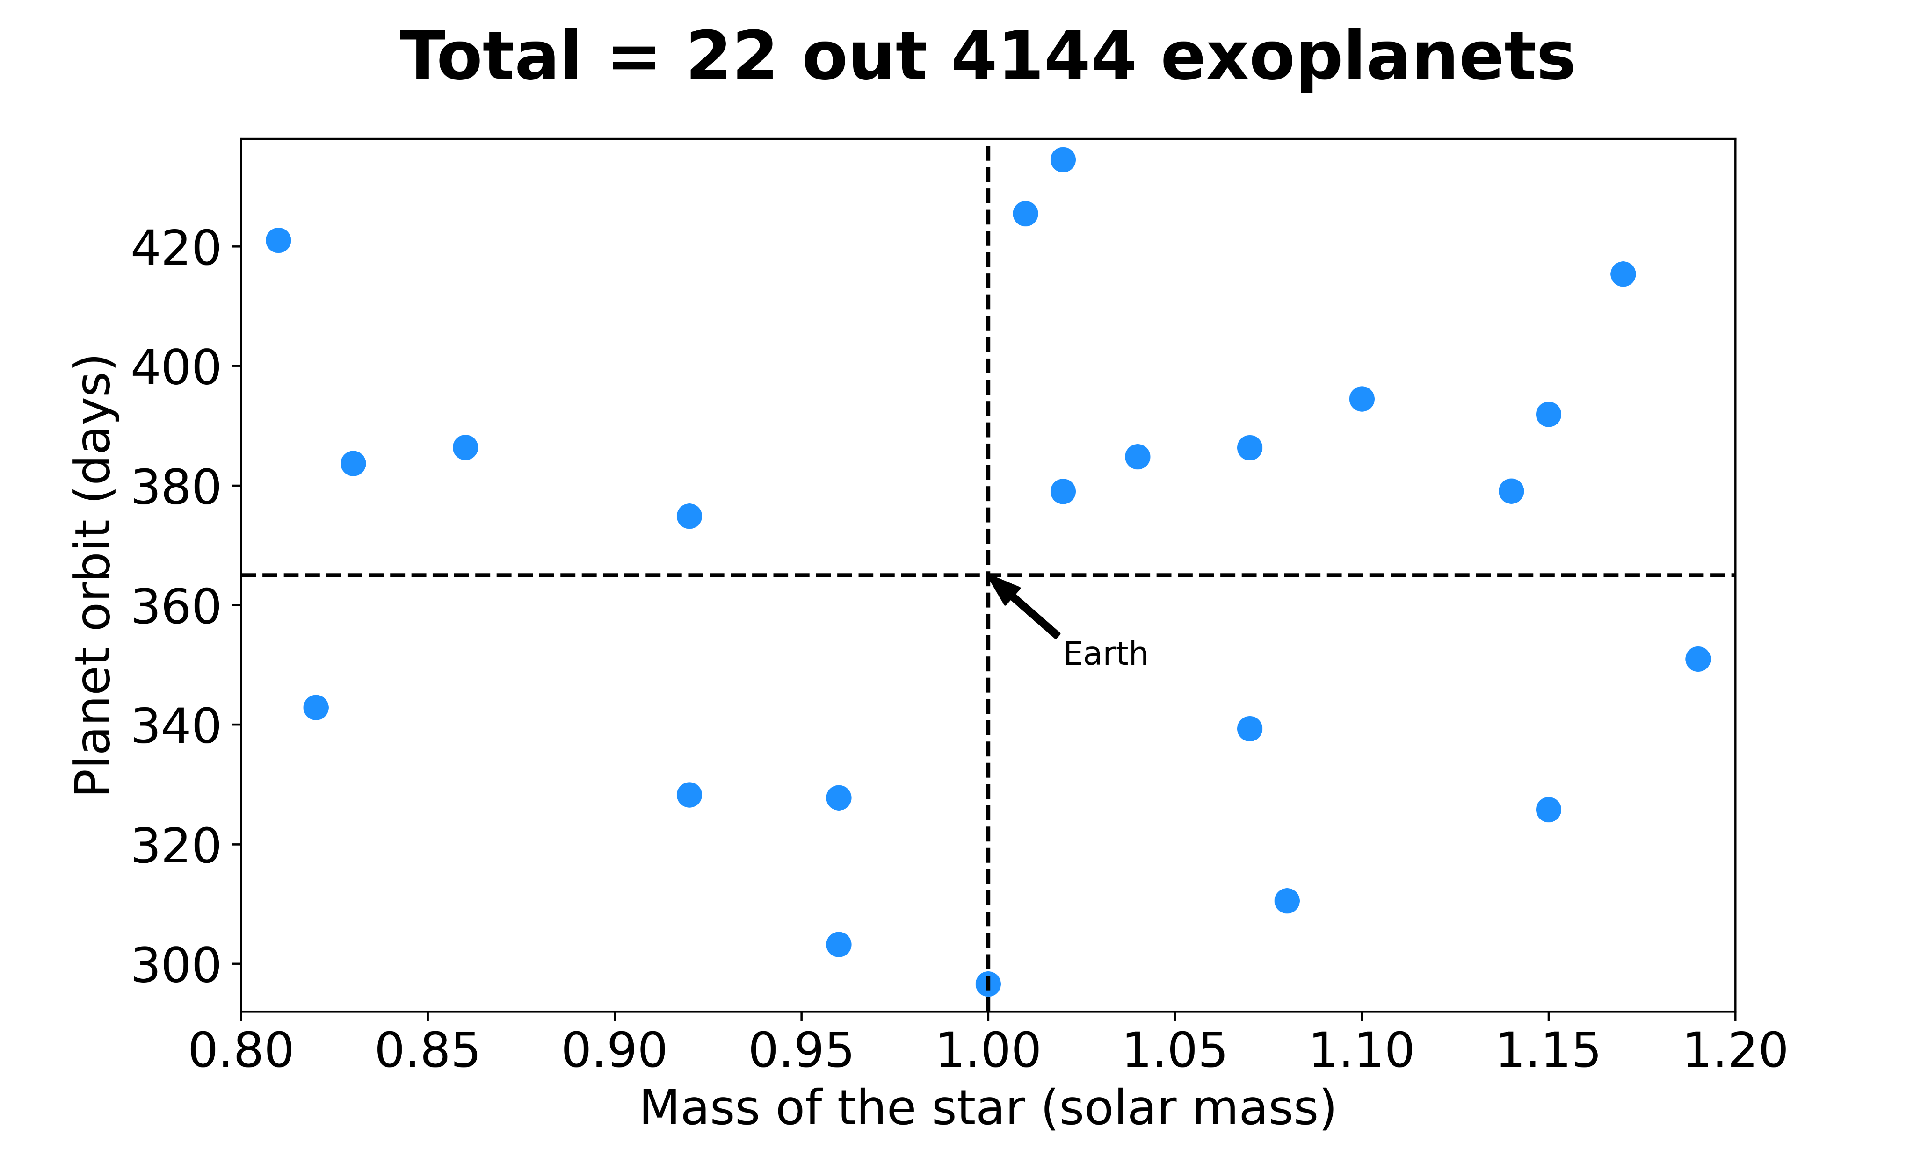
Seems like home!
Exoplanets matching possible conditions to Earth
Notes:
If we narrow down the results to the similar conditions to the Earth-Sun system, we find 22 planets. So these are the planets that resemble more the Earth in terms of the planet orbit

Slide 8
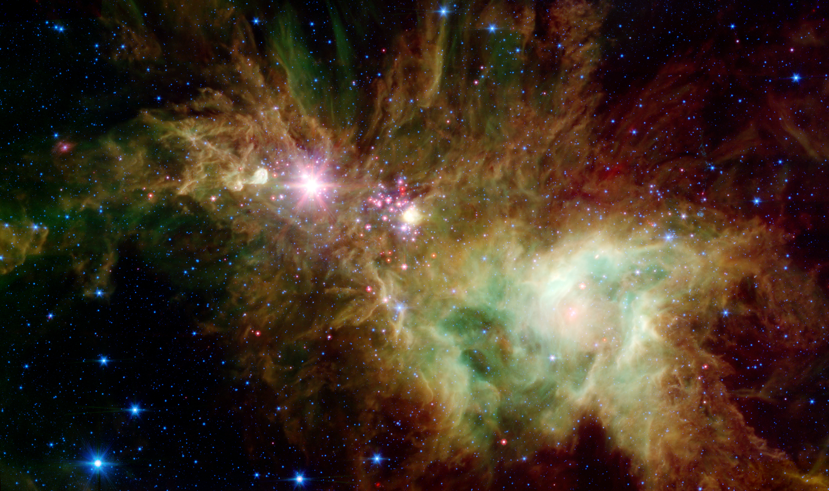
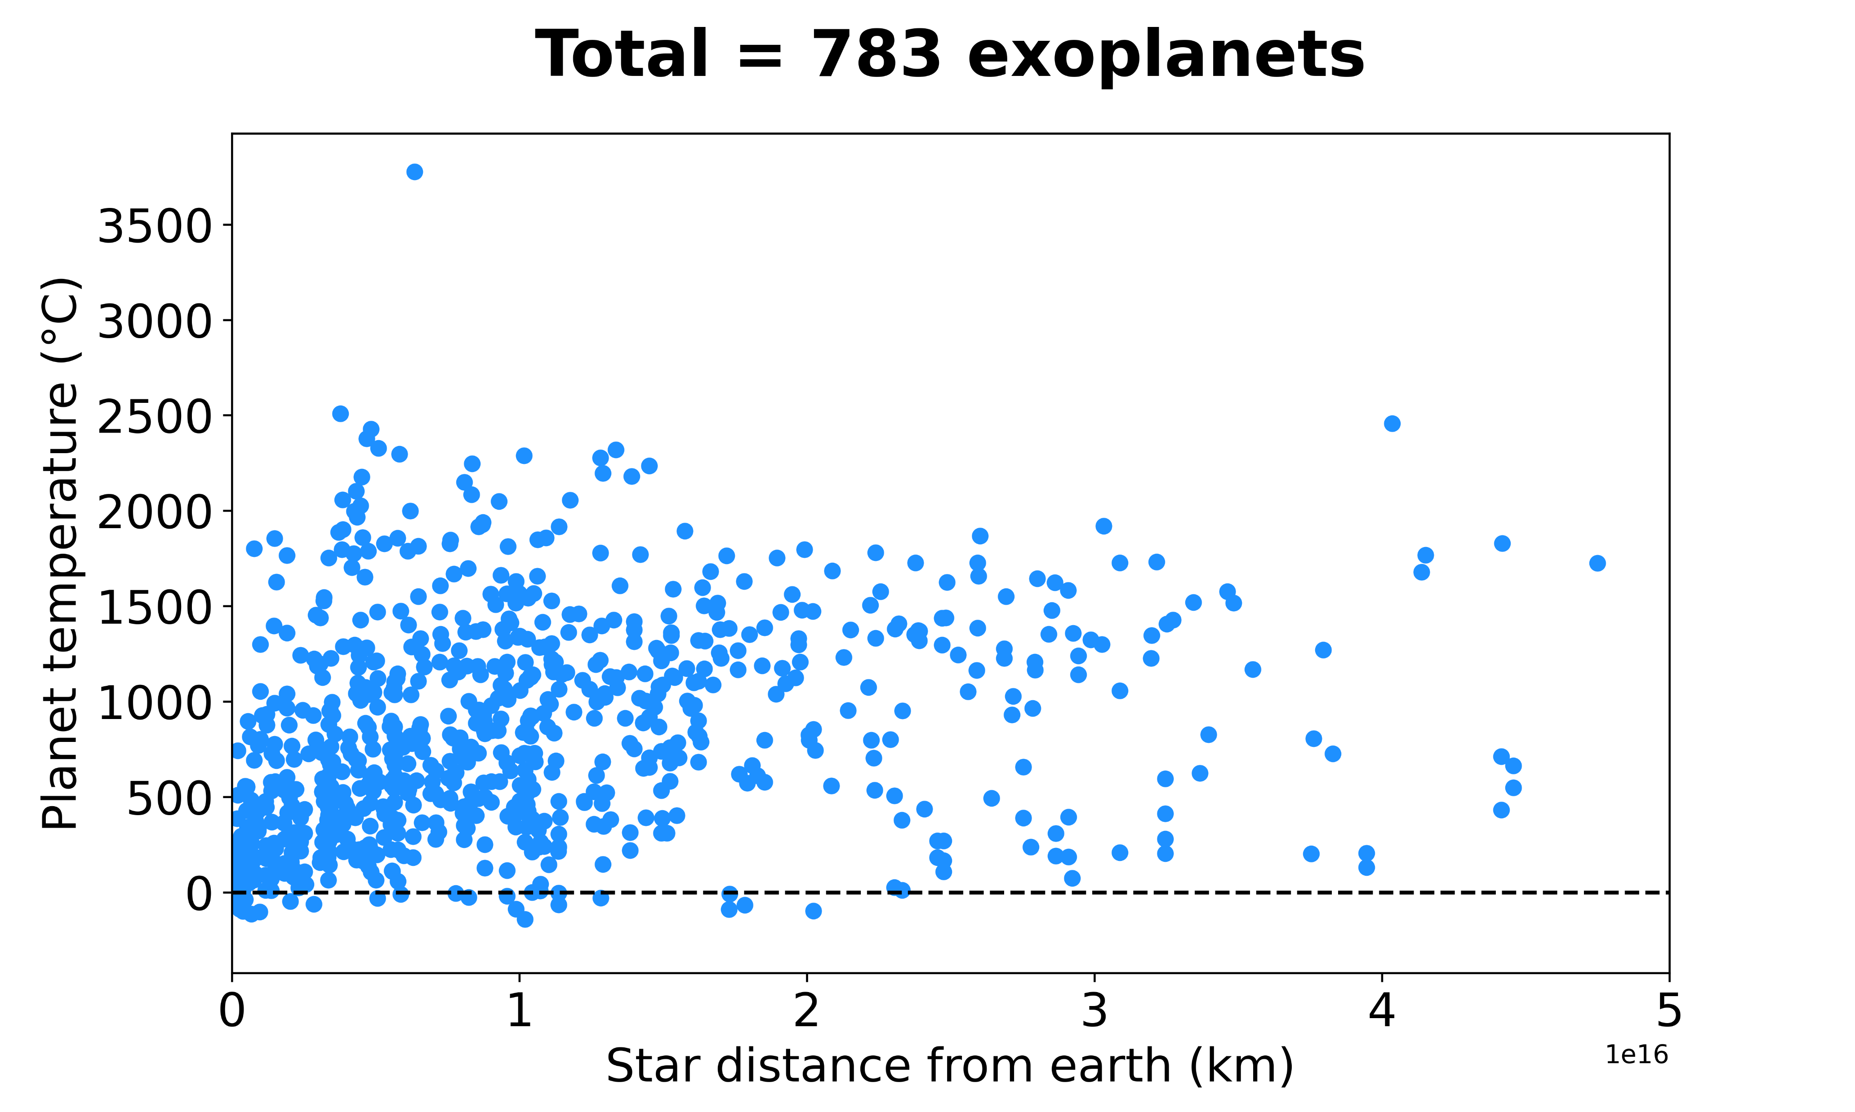
Tropical summer or cold winter?
Notes:
What about the planet temperature?
Since the data from NASA about planet temperature was incomplete, we matched some data found in the EU database to increase the amount of entries. In total, there are 783 planets for which their temperature has been measured or calculated.
We can see that the temperature varies greatly from -170 up to above 3500 °C.

Slide 9
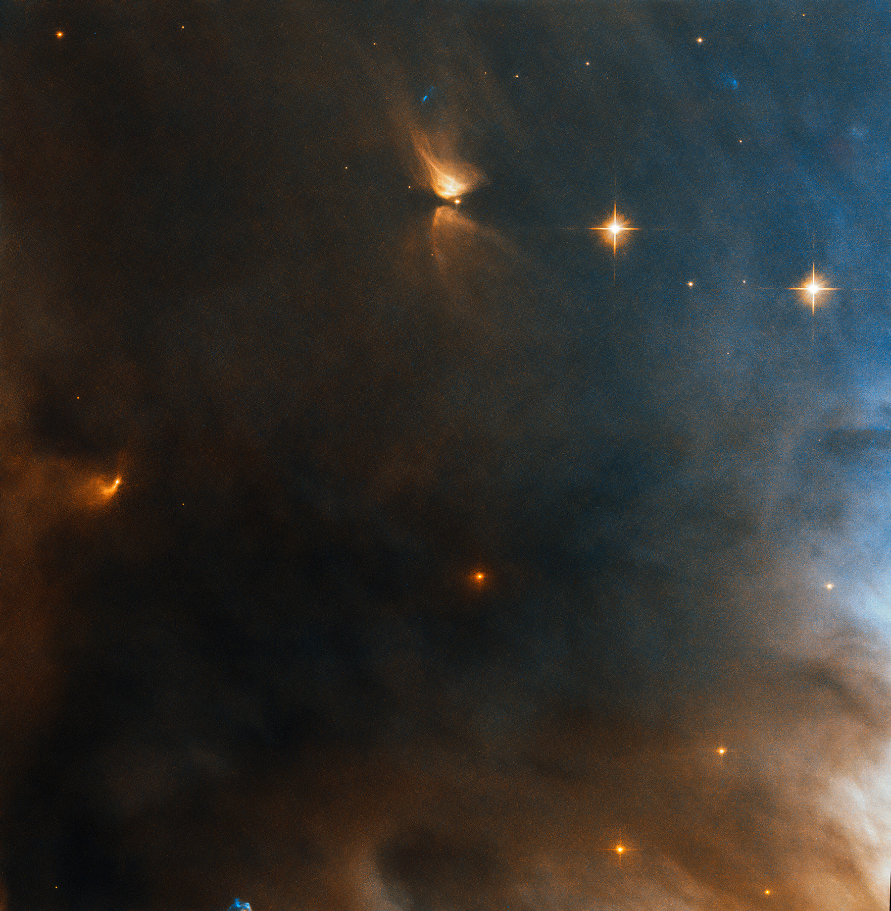
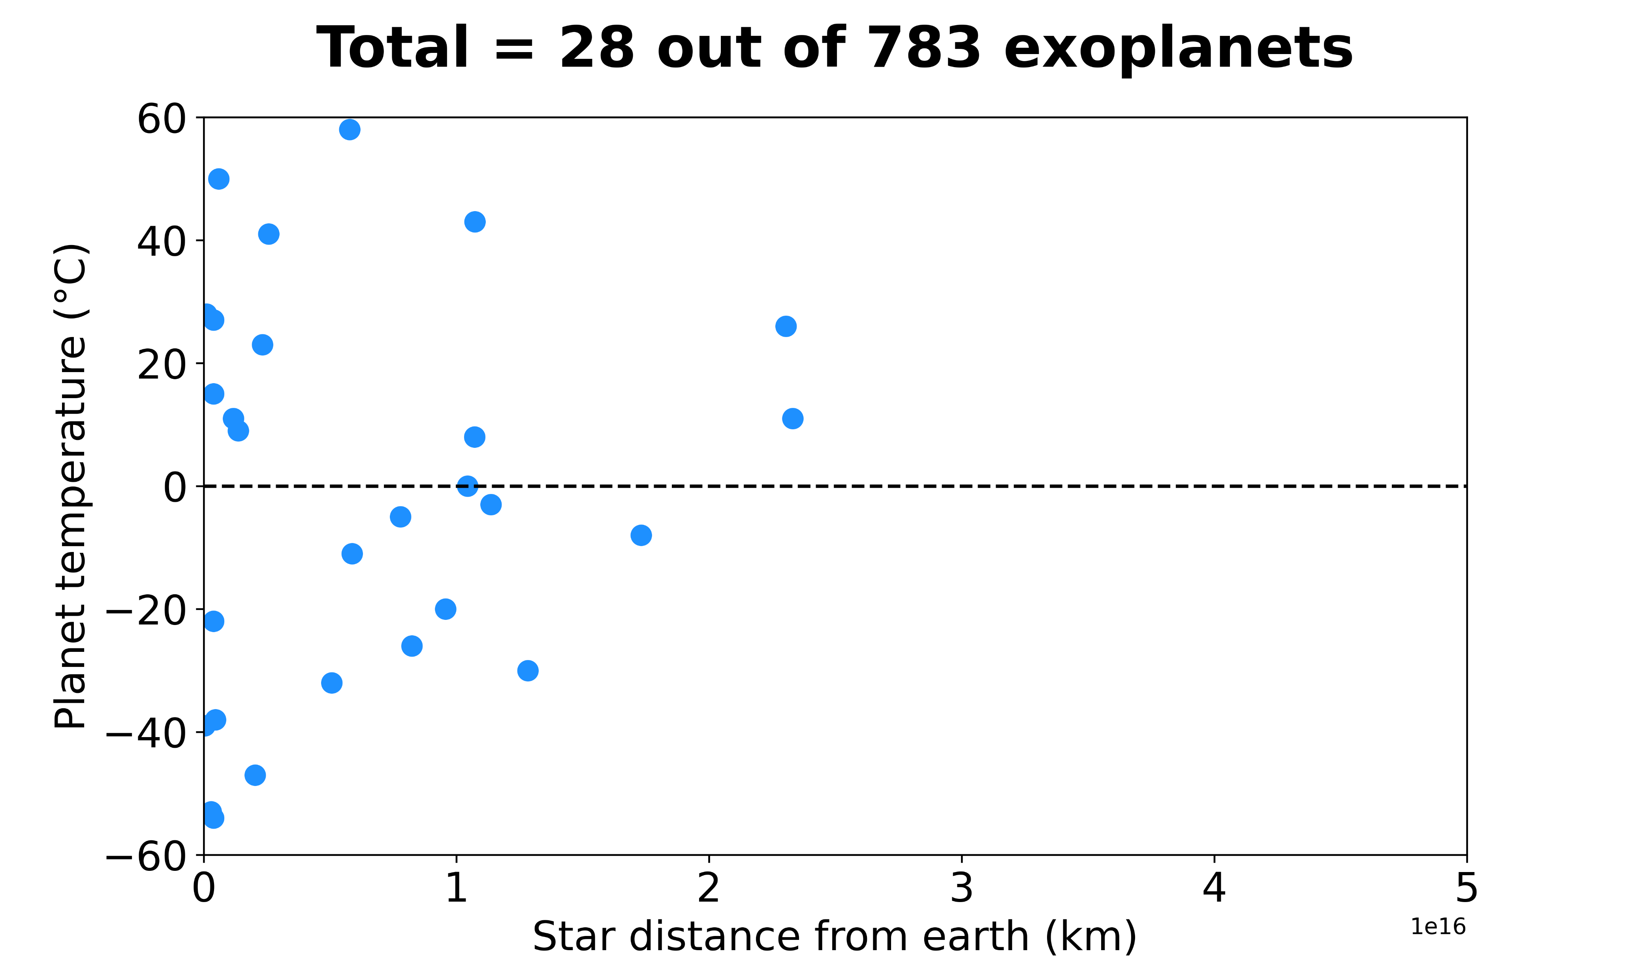
Getting cozier…
Notes:
Narrowing to the range of the earth’s measured temperature, we find only 28 planets.
However, the distance to these systems is 1 million times greater the distance the voyager has traveled from earth, which is 18 billion km!

Slide 10
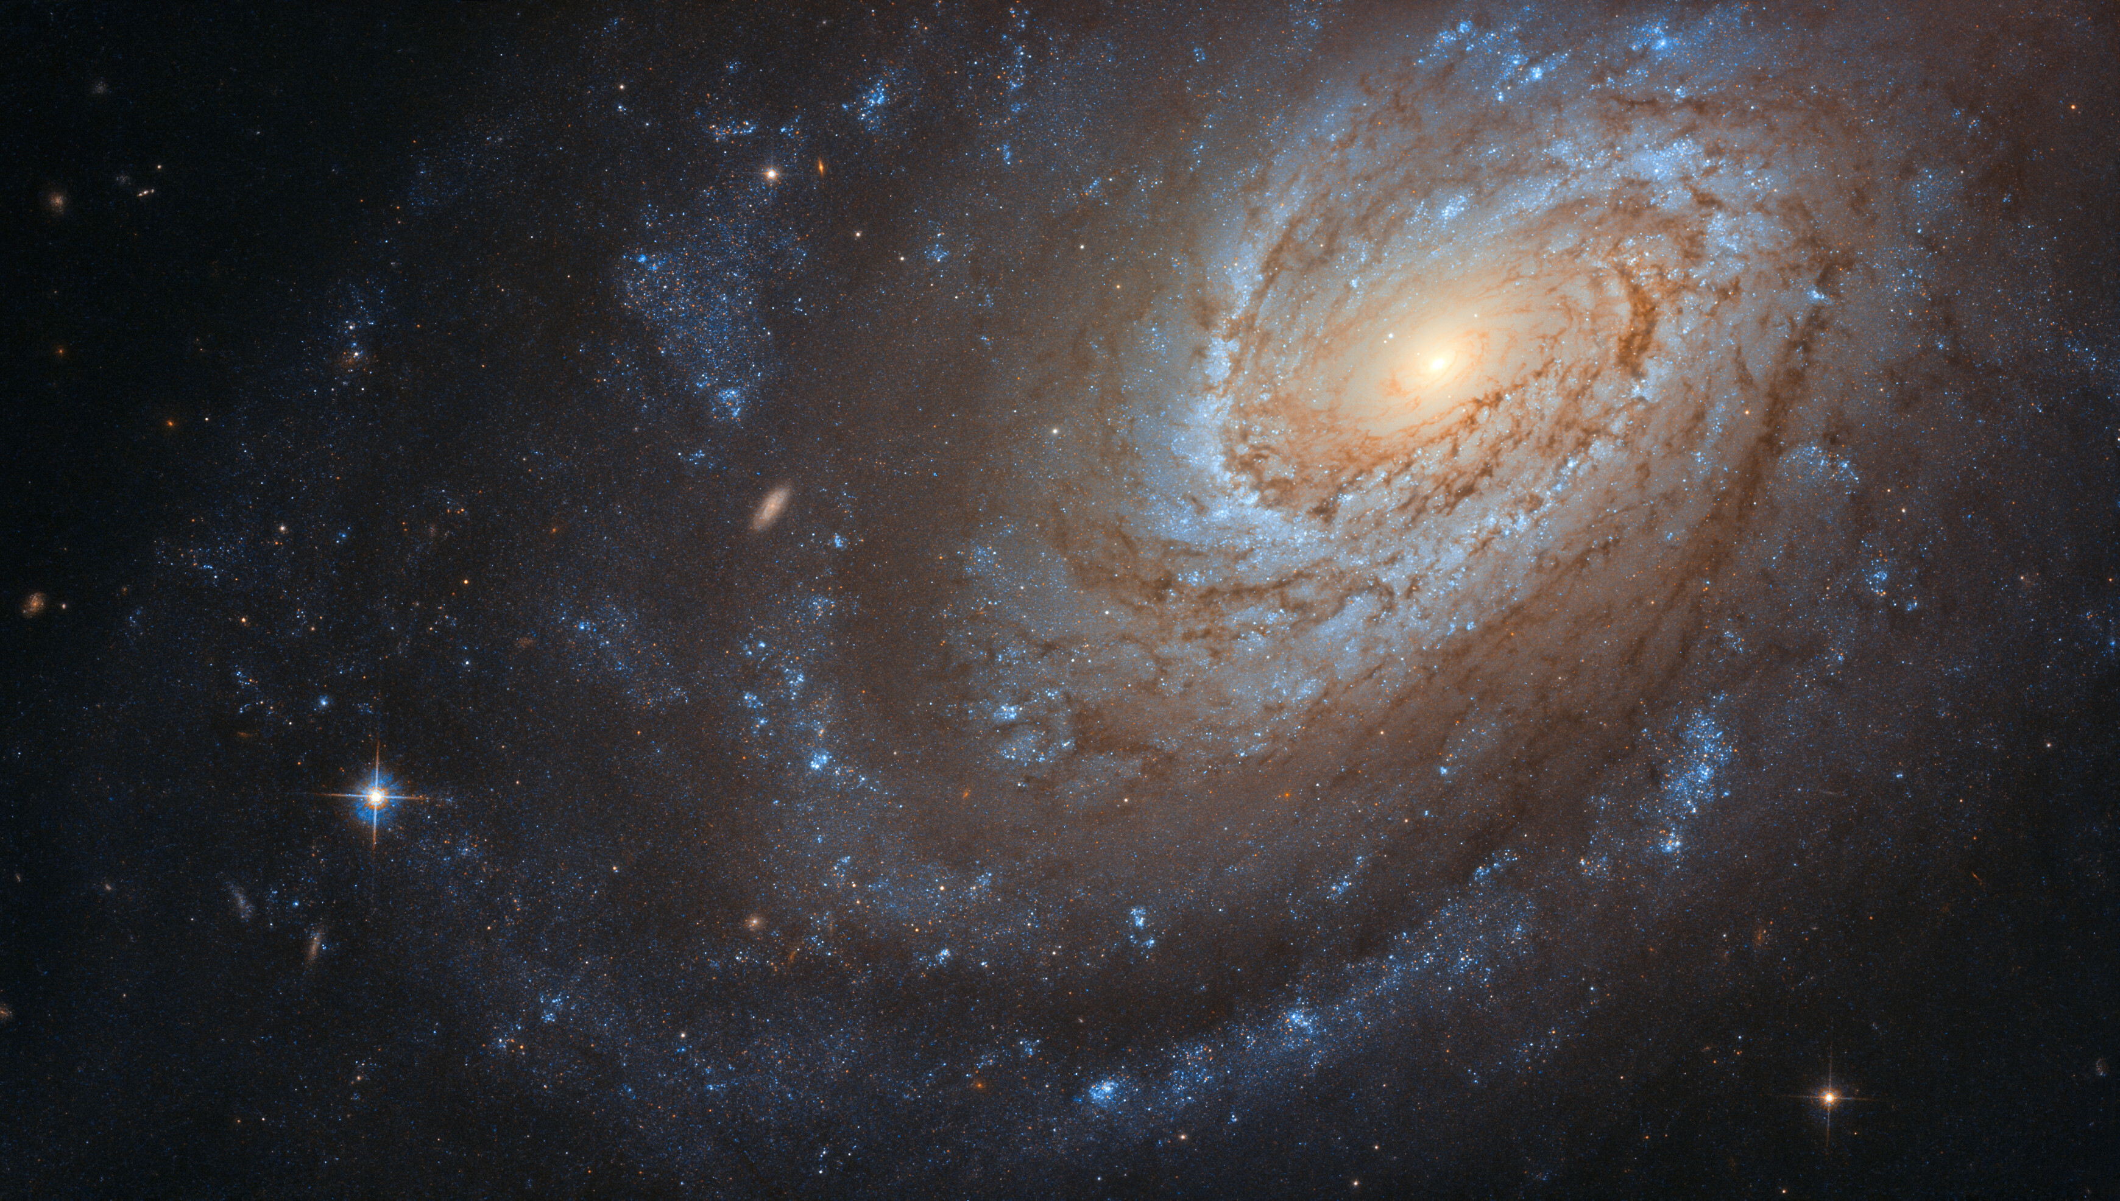
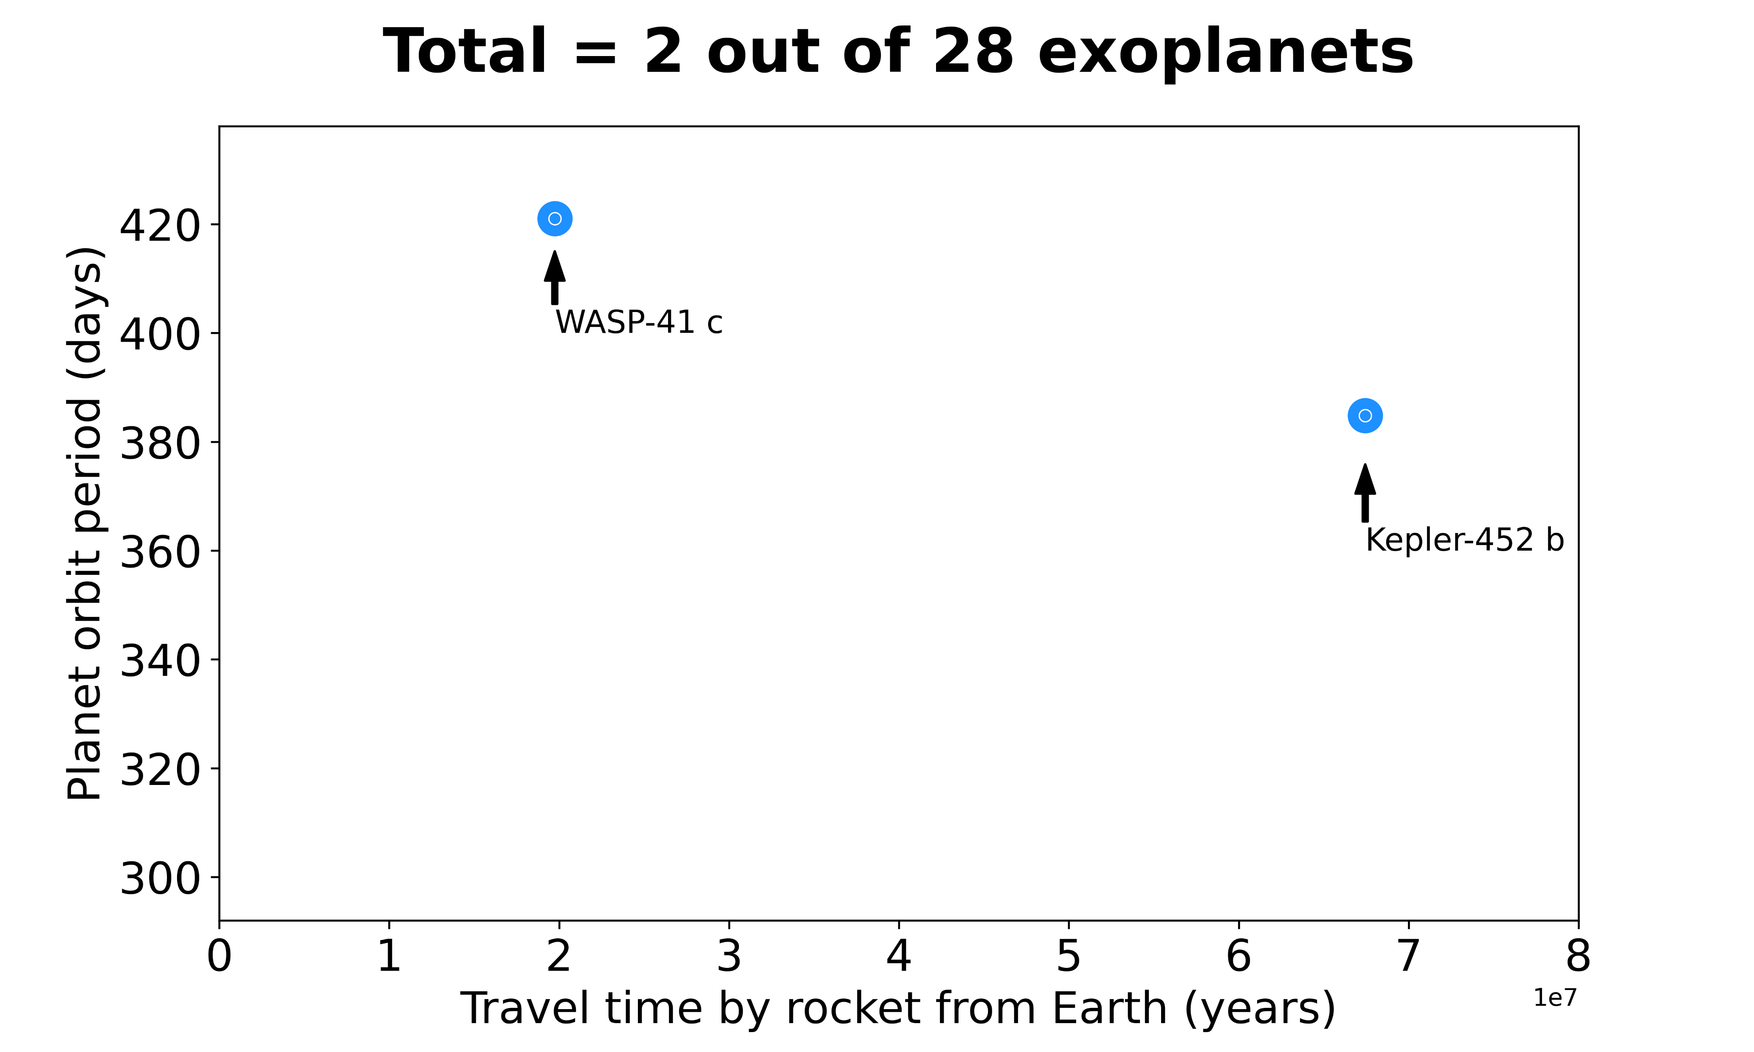
Packing already?
Well, not just yet!
Notes:
If we narrow down even more the choices by comparing the planet orbit to that of the earth, we find 2 planets.
However, WASP-41 c is 1000 times as heavy as earth, so it’s very likely it is a gas planet, but maybe there are some cool moons.
Then finally, there’s Kepler 452 b, which has been identified by NASA as the most earth-like planet considering its size and its orbit around its sun, resembling the Earth-Sun system.
So now that we’ve made our choice, we could travel to Kepler 452 b! BUT the time it would take to reach the planet by a rocket would be approx. 70 million years.

